Slide 1
The Common Core State Standards
Elaborating their Linguistic Foundations

Slide 2

Lau v. Nichols (1974)
Source: Historical Photograph Collection of San Francisco Public Library's San Francisco History Center.

Slide 3
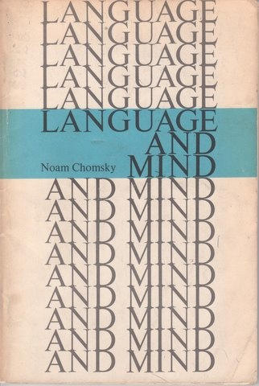
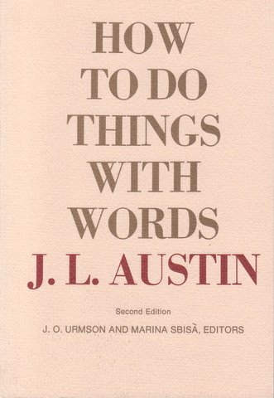
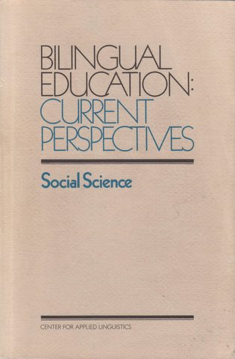
Some Core Epistemological Foundations

Slide 4
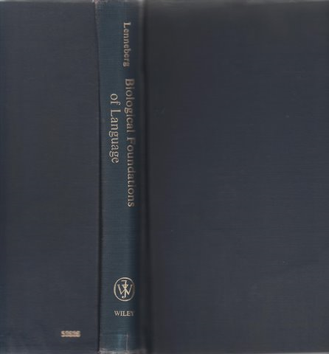
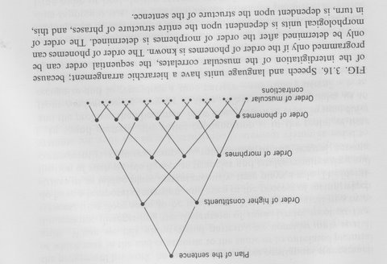
Integrated Nature of Language

Slide 5
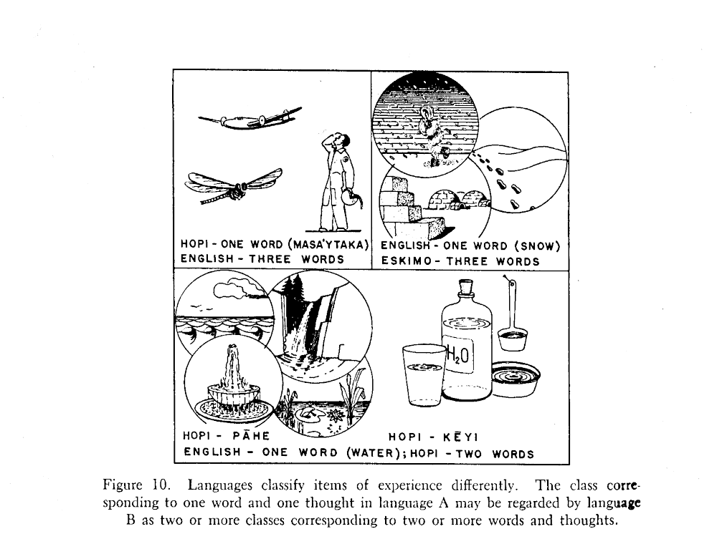
Epistemological Varieties
and
Language
Source: B. L. Whorf (1956). Language, Thought and Reality.

Slide 6


Academic Language: The Cartoon
Semantics, Pragmatics
Small Groups
Classroom
Morphology, Lexicon, Syntax
Phonology, Phonetics
Language
Content
Reading
Assessment

Slide 7
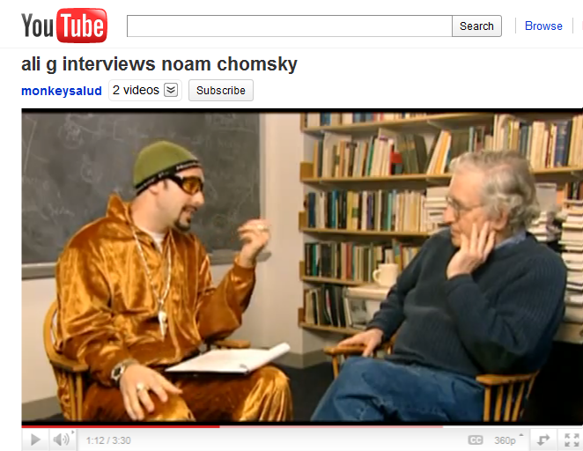
Ali G: How many words does you know?
Chomsky: Well, normally,, humans by maturity have tens of thousands of words.
Ali G: What is some of them?

Slide 8
Ali G: How many words does you know?
Chomsky: Well, normally, humans by maturity have tens of thousands of words.
Ali G: What is some of them?

Slide 9
Ali G: How many words does you know?
Chomsky: Well, normally, humans by maturity have tens of thousands of words.
Ali G: What is some of them?

Slide 10
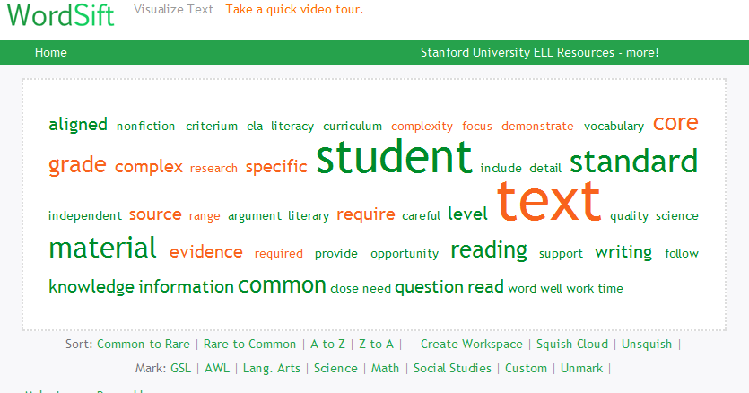
CCSS Publisher’s Guide

Slide 11
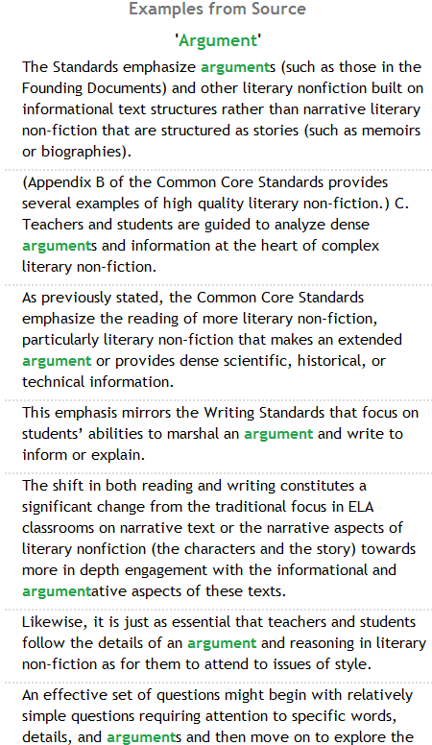
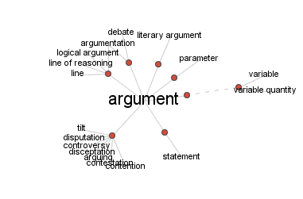
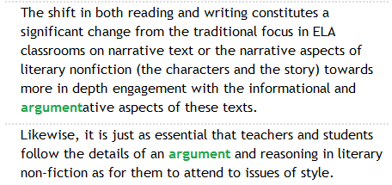


Slide 12
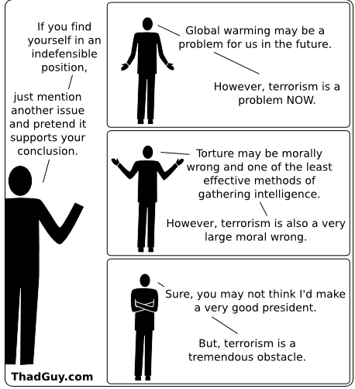

Slide 13
Epistemological Linguistics: a new field
Mapping language to knowledge domains
Sensitivity to all levels of linguistic analysis, from phonetics to macro-sociolinguistics, formal and functional
CS/NLP applications, from parsers to semantic networks (LSA) to brute force approaches

Slide 14
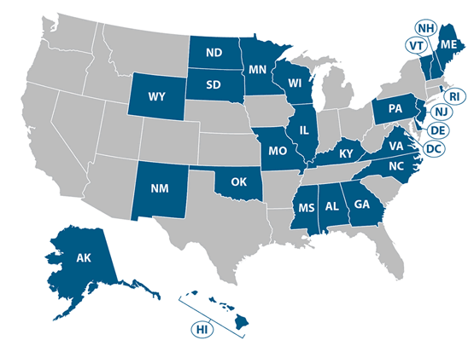
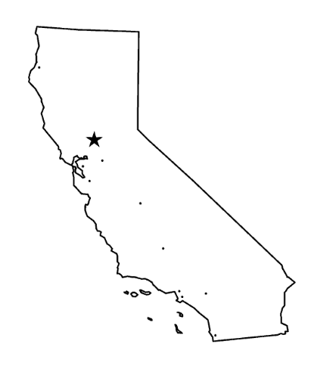

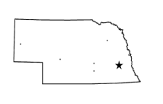

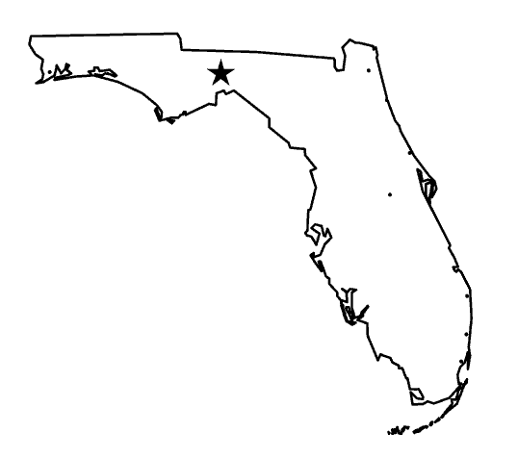
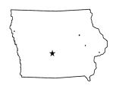


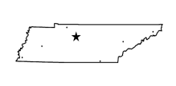
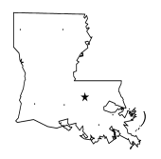

CCSS
WIDA
PARCC
SBAC
“Big Solos”
NE
EAG
IA
The BOX
ELDA
WV
AR
TN
Publishers, Professional Groups, Advocacy Groups
LA
SC
Notes:
The relationship between the common core, the ELP standards, and how there is now an opportunity to re-think the relationship between different parts of the system, especially energized by a more national perspective rather than state-by-state.
1) The common core will define the content standards
2) 44 states have signed up for the common core and they are required to be a part of either PARCC or SBAC
3) PARCC and SBAC are consortia of states that are developing the content assessments for the Common Core – not minor, they are funded by RTTT money ($350M+) to develop these assessments– this will result in common content proficiency tests for all students
At the same time, WIDA, ELDA, Big Solo States working with EAG funds (enhanced assessment grants from the Federal Govt) to enable innovation in English Language proficiency assessments
Policy: ELLs must have access to content and access to language to access the content

Slide 15


